Slide 1
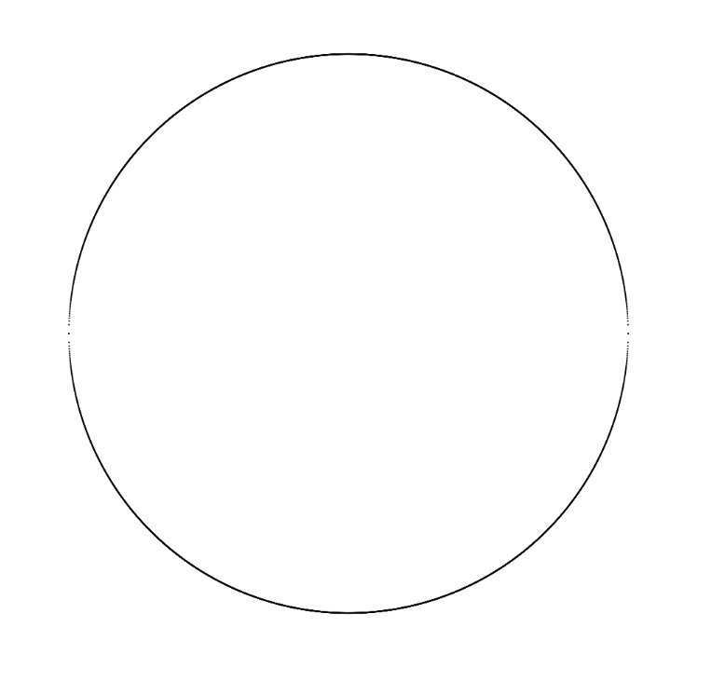
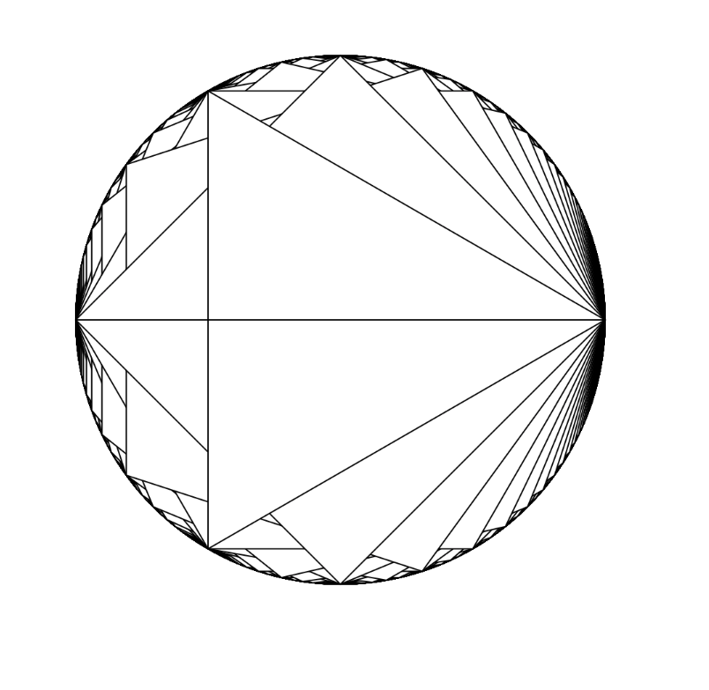
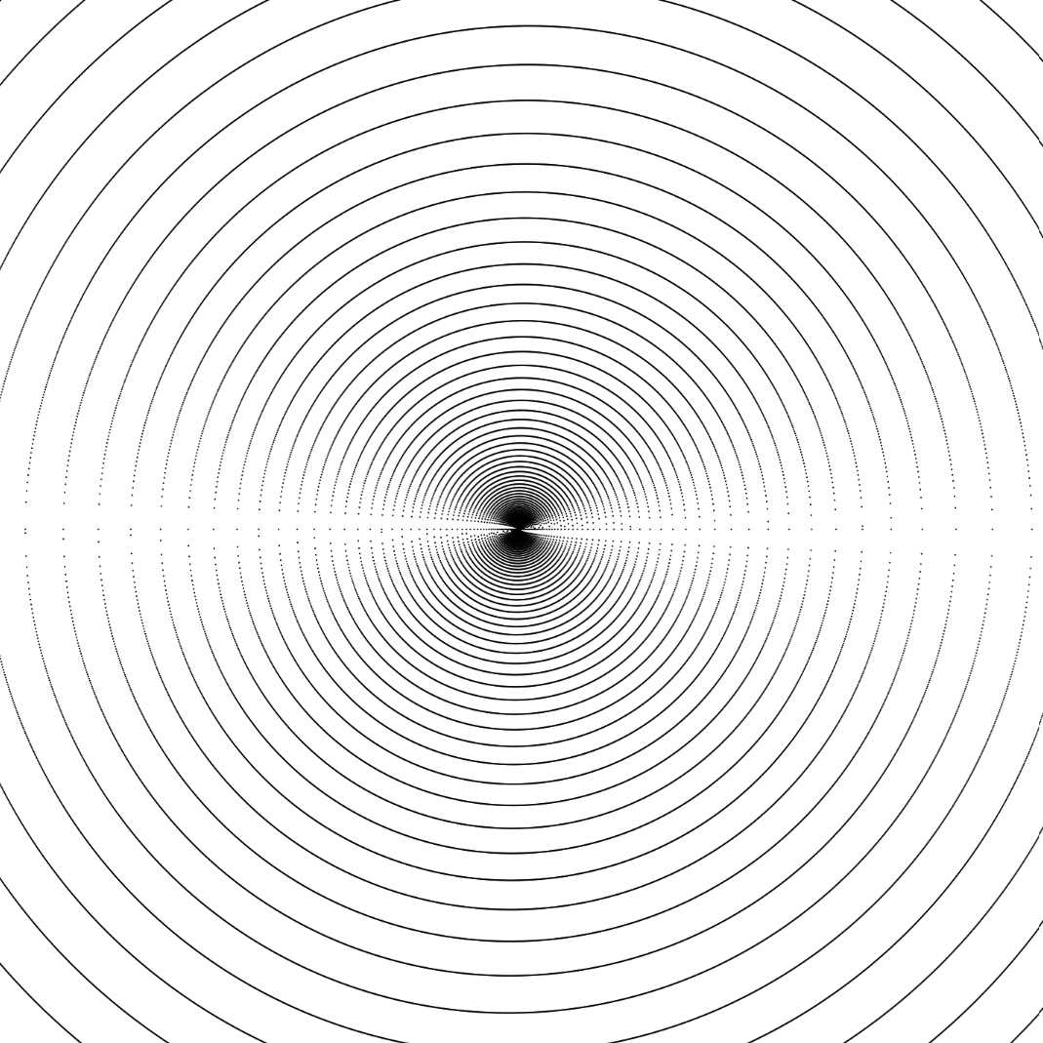
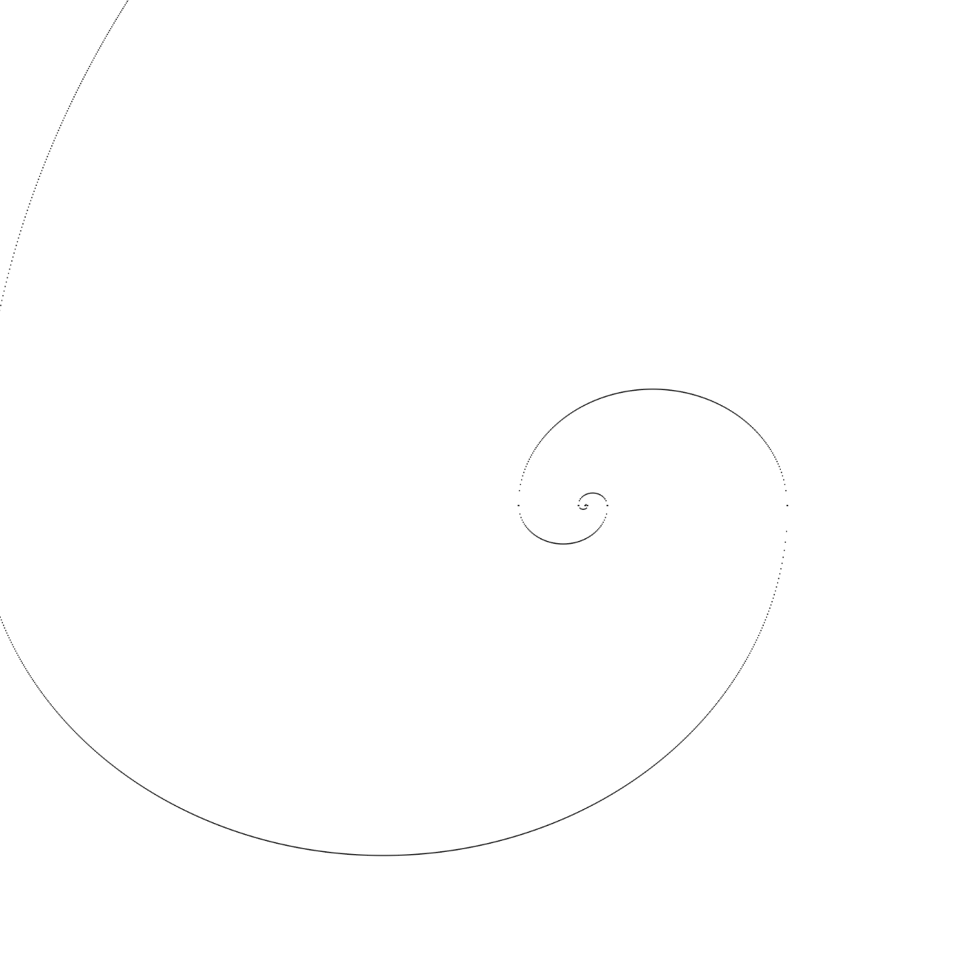
Beautiful Mathematics | Woche 01 | Lukas Bucher
function setup() {
let r = 200;
let xpos = windowWidth / 2;
let ypos = windowHeight / 2;
createCanvas(windowWidth - 40, windowHeight - 40);
drawCircle(xpos, ypos, r);
//drawSpiral(xpos, ypos, 0.5, 5);
}
function drawCircle(xpos, ypos, r) {
for (let x = 0; x <= r; x += 0.1) {
let y = sqrt(r * r - x * x);
point(x + xpos, y + ypos);
point(x + xpos, -y + ypos);
point(-x + xpos, y + ypos);
point(-x + xpos, -y + ypos);
}
}
function drawSpiral(xpos, ypos, growth, size) {
let r = 0;
for (let i = 0; i < size; i++) {
for (let x = r; x >= -r; x--) {
let y = sqrt(r * r - x * x);
point(x + xpos, y + ypos);
r += growth;
}
for (let x = r; x >= -r; x--) {
let y = sqrt(r * r - x * x);
point(-x + xpos, -y + ypos);
r+=growth;
}
}
}
Kreis mit Pythagoras
Polygone
«Spirale» mit Pythagoras 1
«Spirale» mit Pythagoras 2

Slide 2
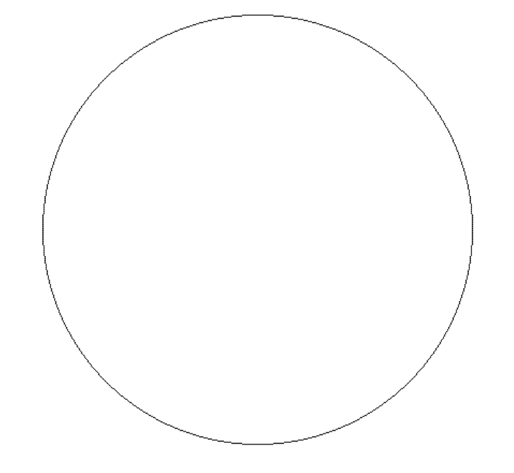
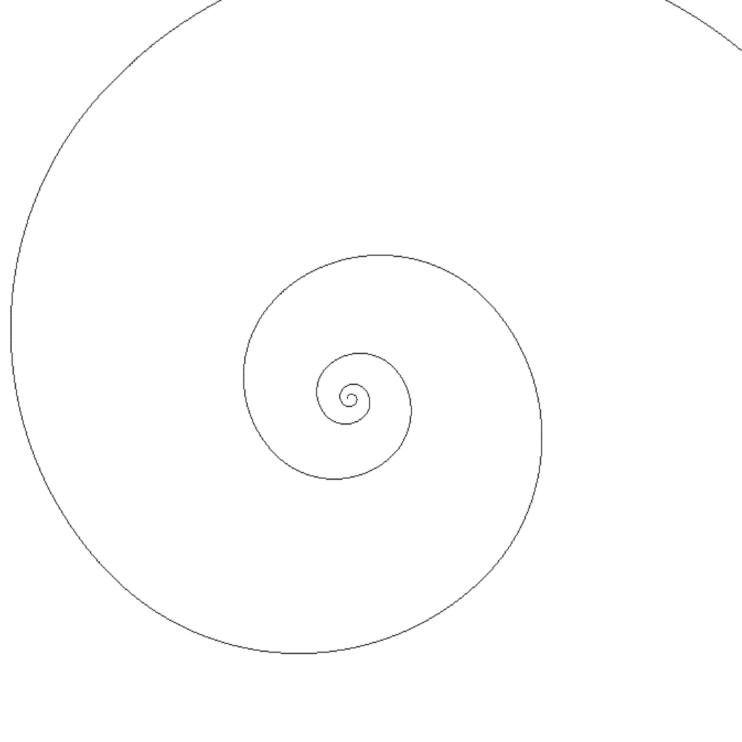
Beautiful Mathematics | Woche 01 | Lukas Bucher
function setup() {
let r = 200;
let xpos = windowWidth * 0.8 / 2;
let ypos = windowHeight * 0.8 / 2;
createCanvas(windowWidth * 0.8, windowHeight * 0.8);
drawCircle(xpos, ypos, r);
//drawSpiral(xpos, ypos, 20, 5);
}
function drawCircle(xpos, ypos, r) {
let x = -r;
let y = 0;
point(x + xpos, y + ypos);
//1/8
while (y > x) {
let r1 = sqrt(x * x + (y - 1) * (y - 1));
let r2 = sqrt((x + 1) * (x + 1) + (y - 1) * (y - 1));
if (Math.abs(r1 - r) > Math.abs(r2 - r)) {
x++;
y--;
} else {
y--;
}
point(x + xpos, y + ypos);
}
//2/8
while (x < 0) {
let r1 = sqrt((x + 1) * (x + 1) + (y - 1) * (y - 1));
let r2 = sqrt((x + 1) * (x + 1) + y * y);
if (Math.abs(r1 - r) > Math.abs(r2 - r)) {
x++;
} else {
x++;
y--;
}
point(x + xpos, y + ypos);
}
//3/8
// (usw. für alle 8 Kreisabschnitte...)
}
Kreis mit Bresenham
Spirale mit Bresenham

Slide 3
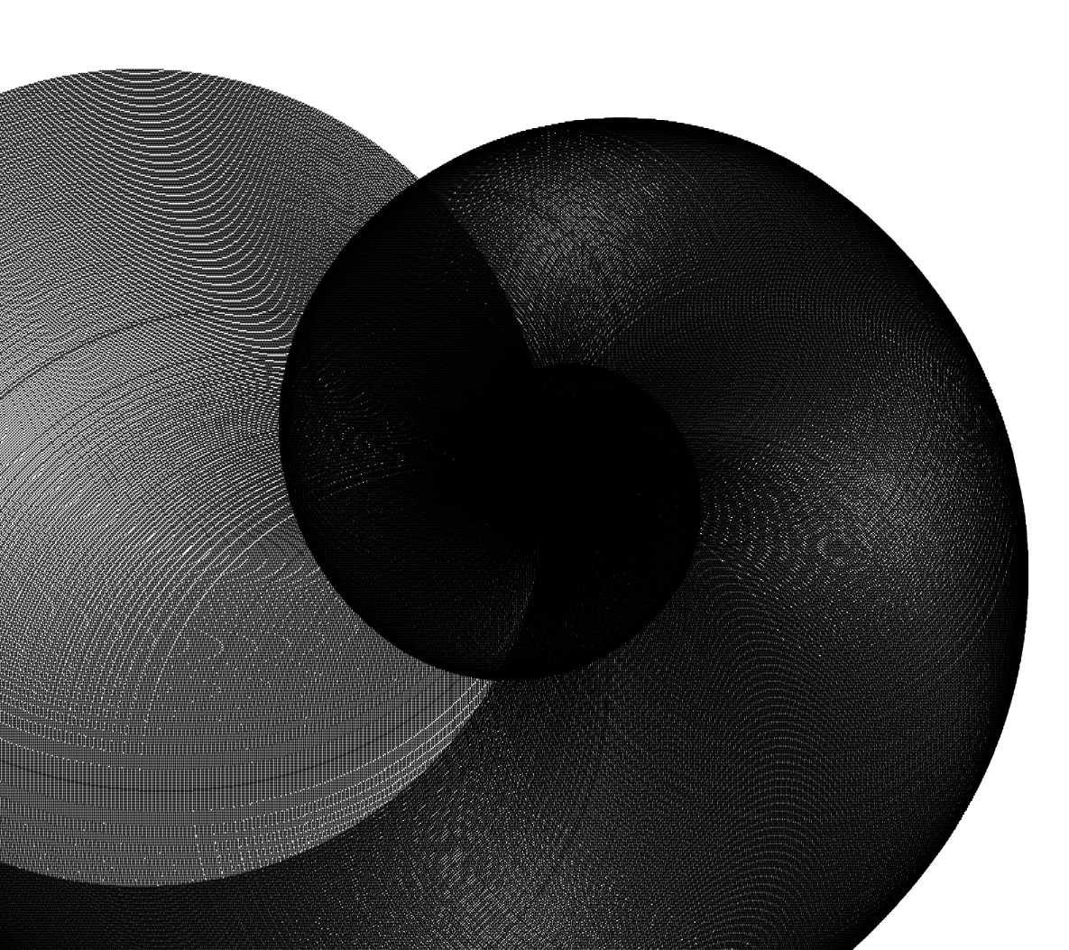
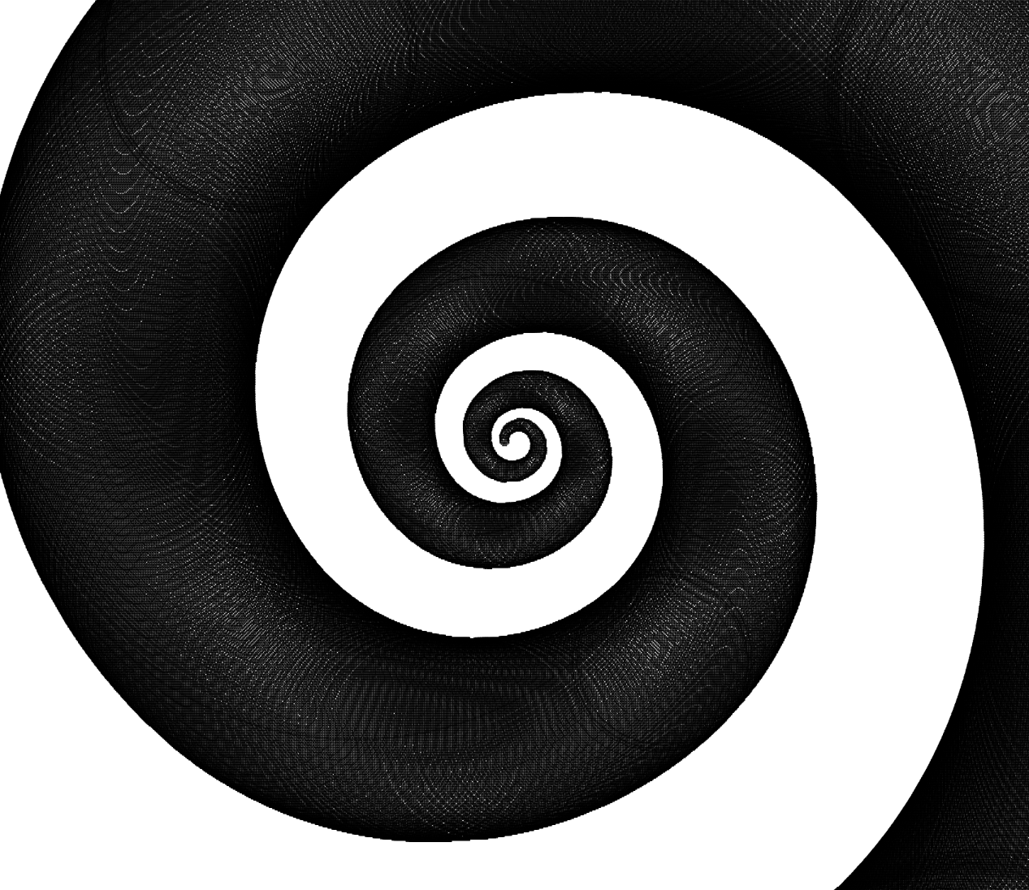
Beautiful Mathematics | Woche 01 | Lukas Bucher
function setup() {
let r = 200;
let xpos = windowWidth * 0.8 / 2;
let ypos = windowHeight * 0.8 / 2;
createCanvas(windowWidth * 0.8, windowHeight * 0.8);
//drawSpiral(xpos, ypos, 12, 6);
drawSpiral(xpos, ypos, 20, 3);
}
function drawSpiral(xpos, ypos, growth, size) {
growth *= 0.01;
let r = 10;
let x = -r;
let y = 0;
drawCircle(x + xpos, y + ypos, r / 3);
r += growth;
for (let i = 0; i <= size; i++) {
console.log(x + " " + y);
//1/8
while (y >= x) {
let r0 = sqrt((x - 1) * (x - 1) + (y - 1) * (y - 1));
let r1 = sqrt(x * x + (y - 1) * (y - 1));
let r2 = sqrt((x + 1) * (x + 1) + (y - 1) * (y - 1));
if (Math.abs(r1 - r) > Math.abs(r2 - r)) {
x++;
y--;
} else if (Math.abs(r0 - r) > Math.abs(r1 - r)) {
y--;
} else {
x--;
y--;
}
drawCircle(x + xpos, y + ypos, r / 3);
r += growth;
}
//2/8
// (usw. für alle 8 Spiralenabschnitte...)
}
function drawCircle(xpos, ypos, r) {
// (...)
}
}
Kreis-Spirale 1
Kreis-Spirale 2
Spiralen aus grösser werdenden Kreisen mit Bresenham

Slide 4
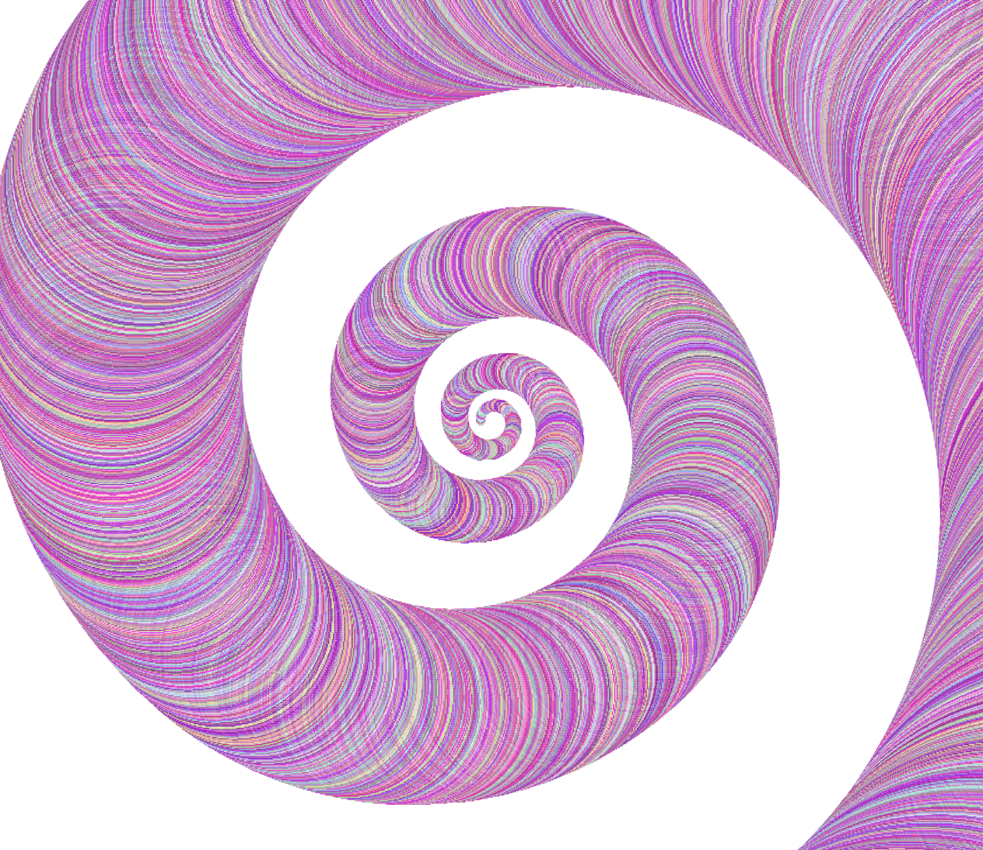
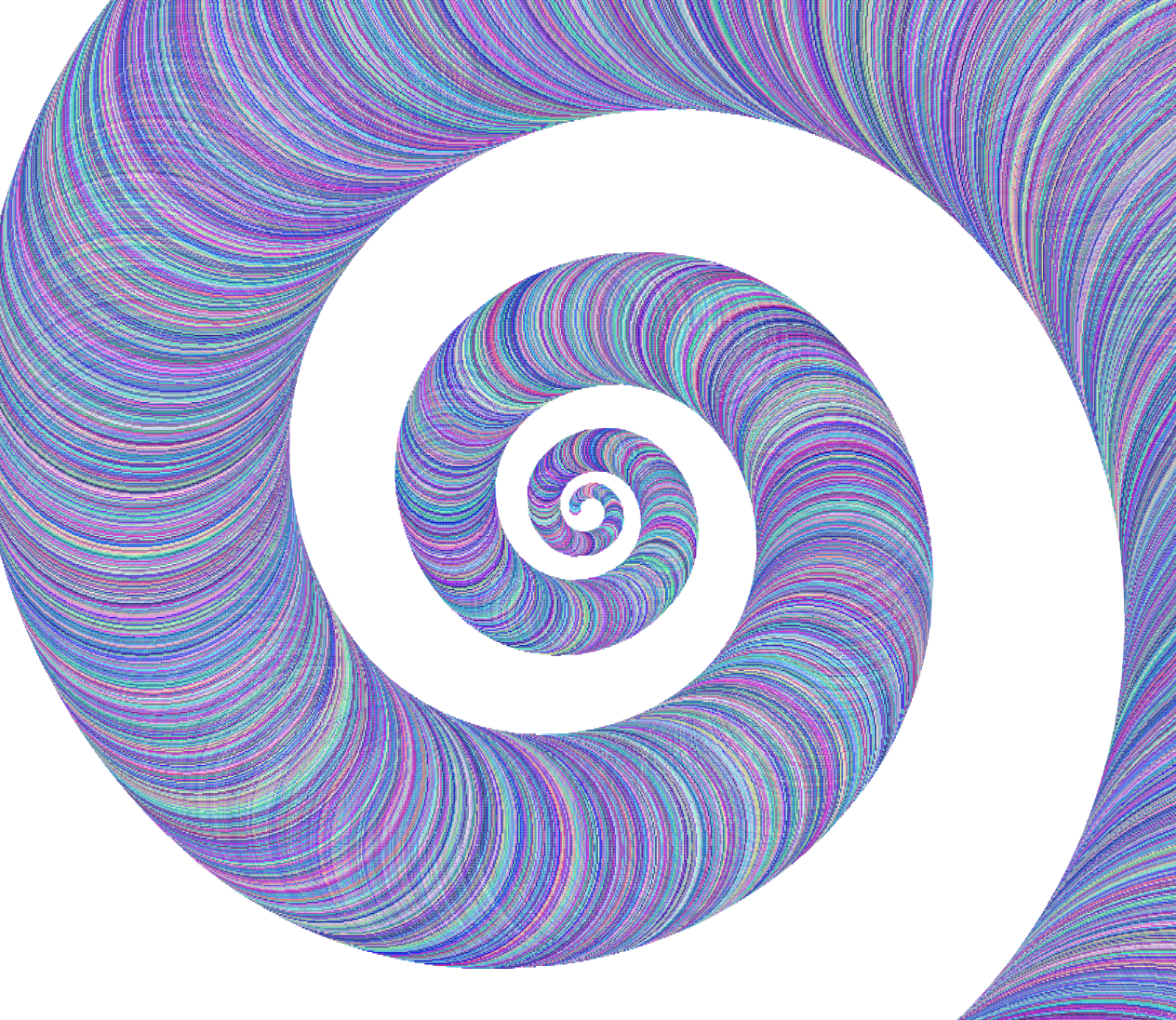
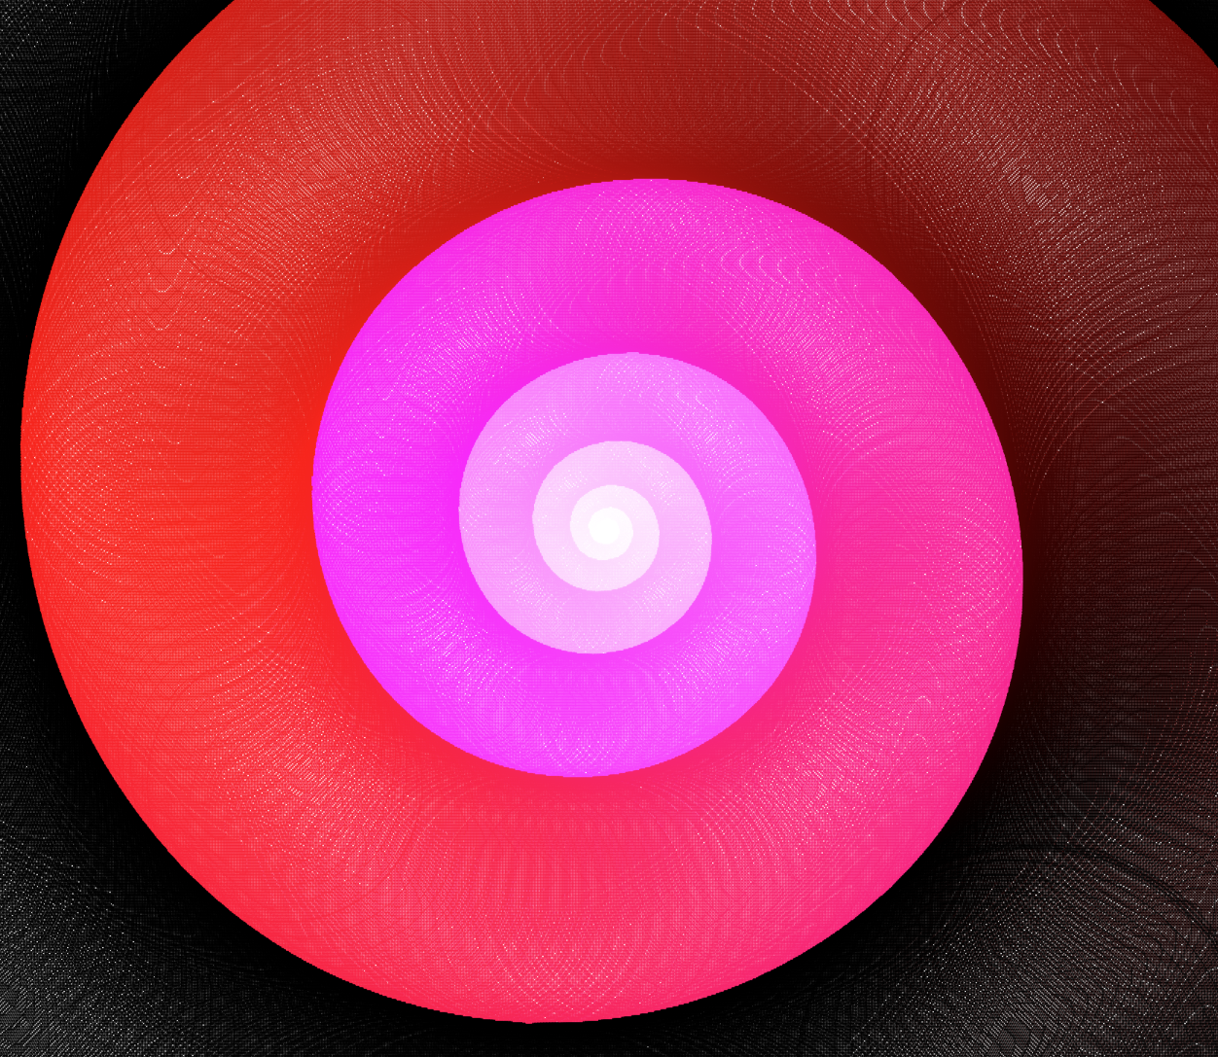
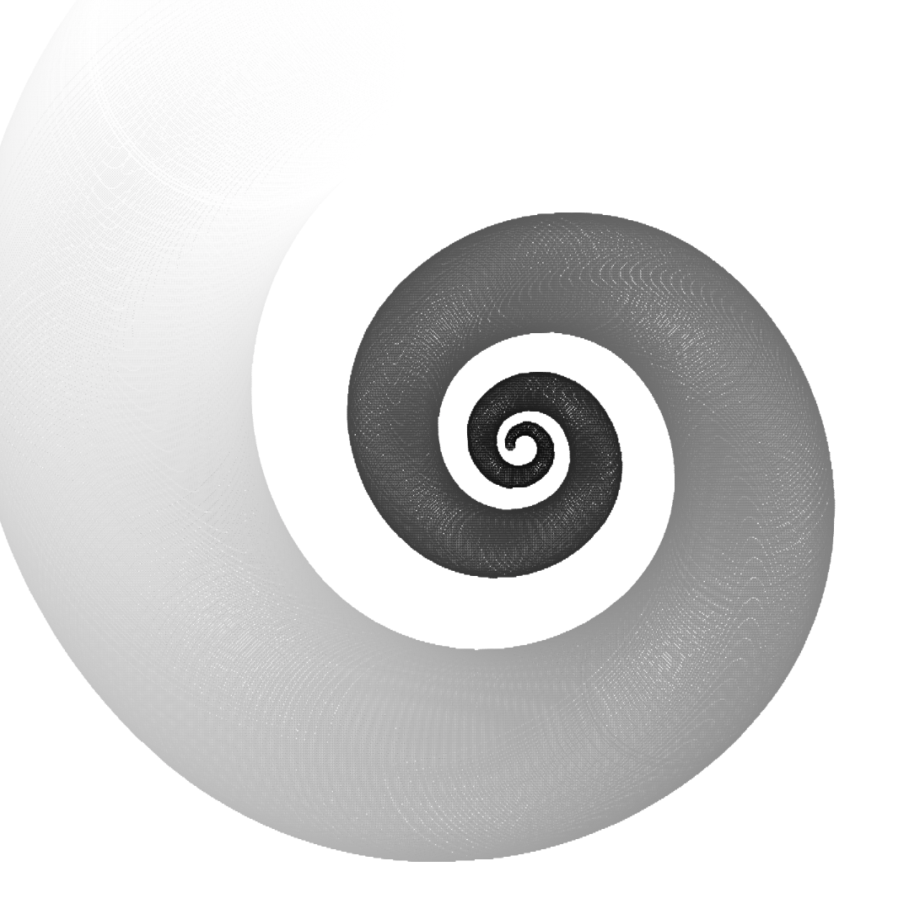
Beautiful Mathematics | Woche 01 | Lukas Bucher
//(...)
let red = 255;
let green = 255;
let blue = 255;
//(...)
//Spirale 3
if (green > 0) {
green -= 0.2;
} else if (blue > 0) {
blue -= 0.2;
} else if (red > 0) {
red -= 0.2;
}
//Spirale 1
red = random(255) * 0.5 + 127.5;
green = random(255);
blue = random(255) * 0.5 + 127.5;
//Spirale 4
red = r * 2;
green = r * 2;
blue = r * 2;
//(...)
Spirale 1
Spirale 2
Spirale 3
Spirale 4
Experimente mit Farbe

Slide 6
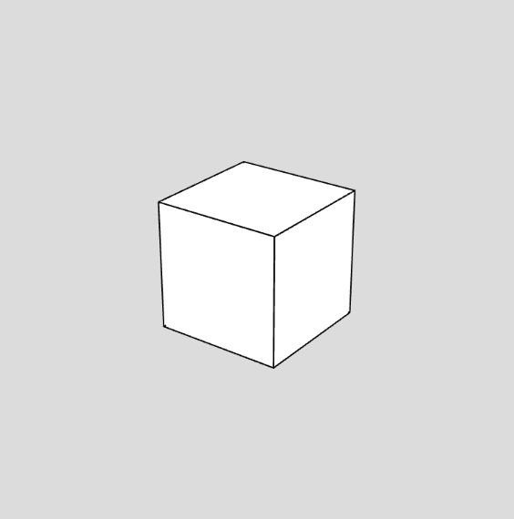
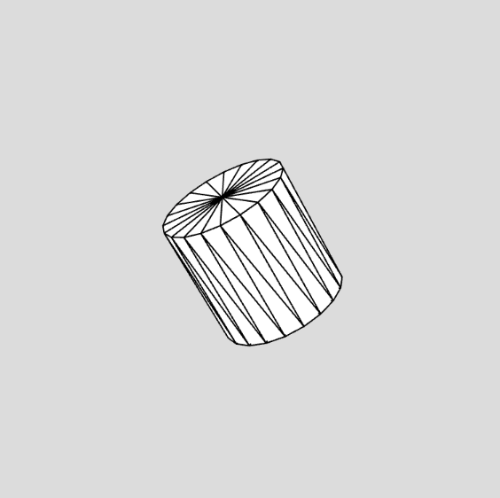
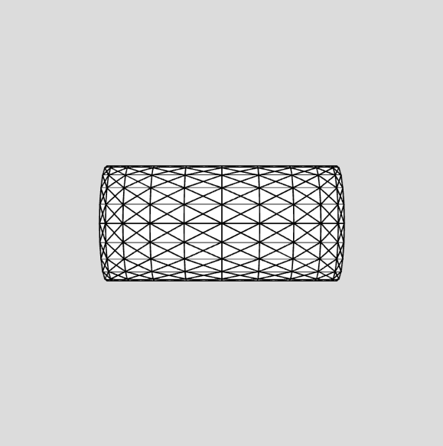
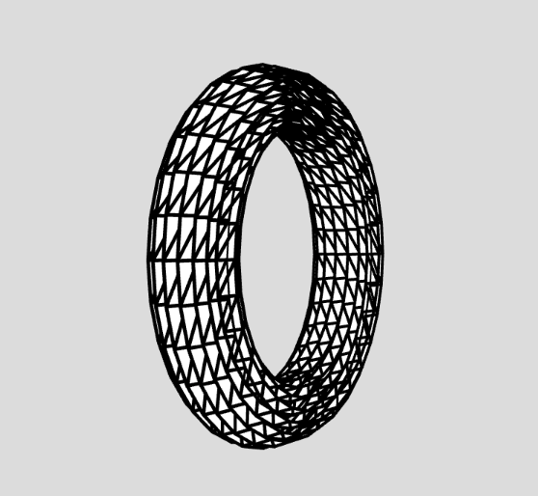
Beautiful Mathematics | Woche 02 | Lukas Bucher
//(...)
function drawCylinder(radius, height) {
let angle = TWO_PI / numSides;
beginShape(TRIANGLE_STRIP);
for (let i = 0; i <= numSides; i++) {
let x = radius * cos(angle * i);
let y = radius * sin(angle * i);
let z = height / 2;
vertex(x, y, z);
vertex(x, y, -z);
}
endShape(CLOSE);
beginShape(TRIANGLE_FAN);
vertex(0, 0, height / 2);
for (let i = 0; i <= numSides; i++) {
let x = radius * cos(angle * i);
let y = radius * sin(angle * i);
vertex(x, y, height / 2);
}
endShape(CLOSE);
beginShape(TRIANGLE_FAN);
vertex(0, 0, -height / 2);
for (let i = 0; i <= numSides; i++) {
let x = radius * cos(angle * i);
let y = radius * sin(angle * i);
vertex(x, y, -height / 2);
}
endShape(CLOSE);
}
//(...)
Würfel
Zylinder
«Zylinder» / «Torus»
«Torus»

Slide 7
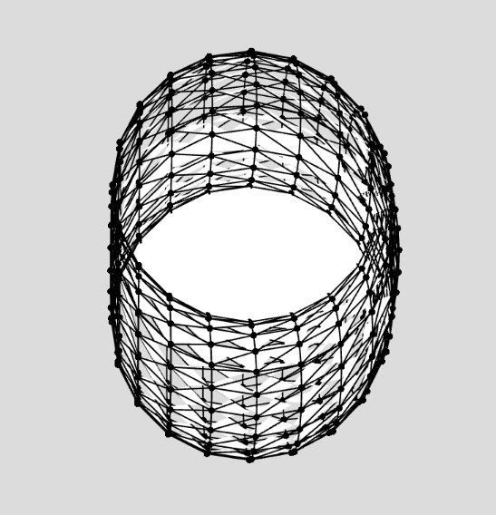
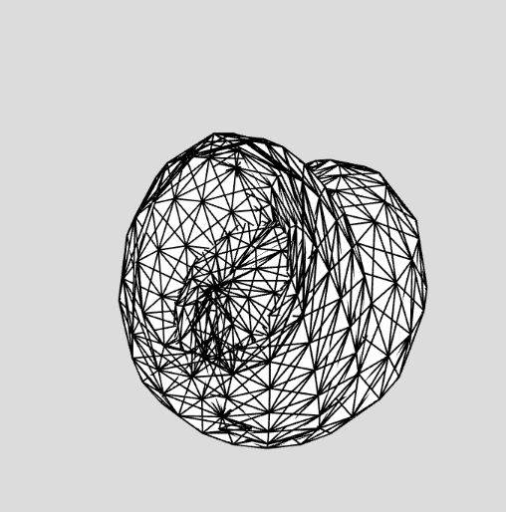
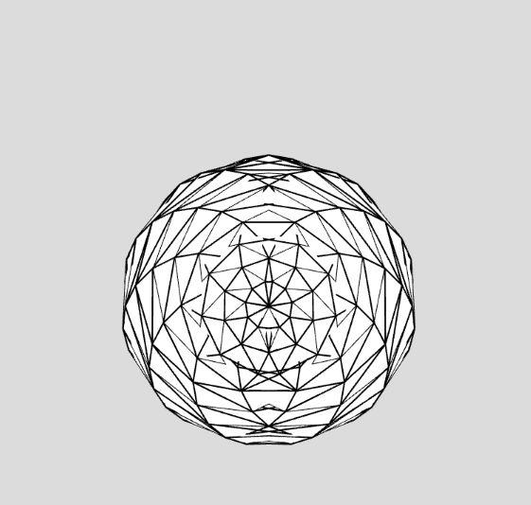
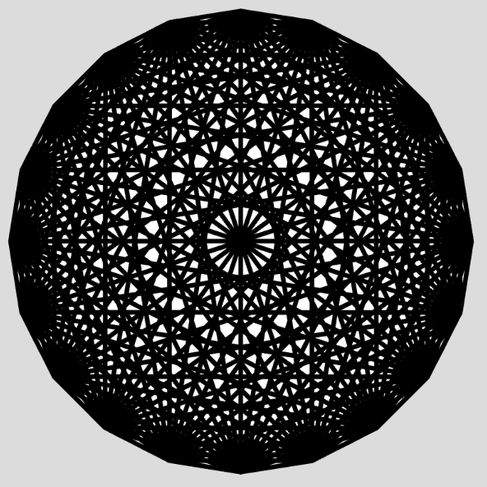
Beautiful Mathematics | Woche 02 | Lukas Bucher
//(...)
//Torus 4
function drawTorus(radius, tubeRadius) {
beginShape(TRIANGLES);
fill(255);
stroke(0);
strokeWeight(1);
let numSides = 20;
let vertices = [];
let angle = TWO_PI / numSides;
for (let i = 0; i < numSides; i++) {
let x = radius * cos(angle * i);
let y = radius * sin(angle * i);
for (let j = 0; j < numSides; j++) {
let y = tubeRadius * sin(angle * j);
let z = tubeRadius * cos(angle * j);
vertices.push([x, y, z]);
}
}
for (let i = 0; i < numSides; i++) {
let x = radius * cos(angle * i);
let y = radius * sin(angle * i);
for (let j = 0; j < numSides; j++) {
let z = tubeRadius * cos(angle * j);
let a = (i + 1) % numSides;
let b = (j + 1) % numSides;
let c = (i + 1) % numSides;
let d = (j + 1) % numSides;
vertex(vertices[i][0], vertices[i][1], vertices[i][2]);
vertex(vertices[a][0], vertices[a][1], vertices[a][2]);
vertex(vertices[b][0], vertices[b][1], vertices[b][2]);
vertex(vertices[i][0], vertices[i][1], vertices[i][2]);
vertex(vertices[c][0], vertices[c][1], vertices[c][2]);
vertex(vertices[d][0], vertices[d][1], vertices[d][2]);
}
}
endShape(CLOSE);
}
//(...)
«Torus» 1
«Torus» 2
«Torus» 3
«Torus» 4
Der Weg zum Torus

Slide 8
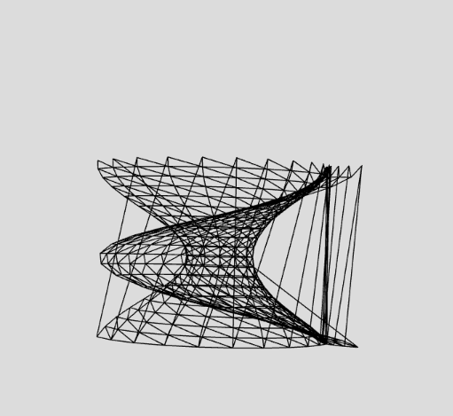
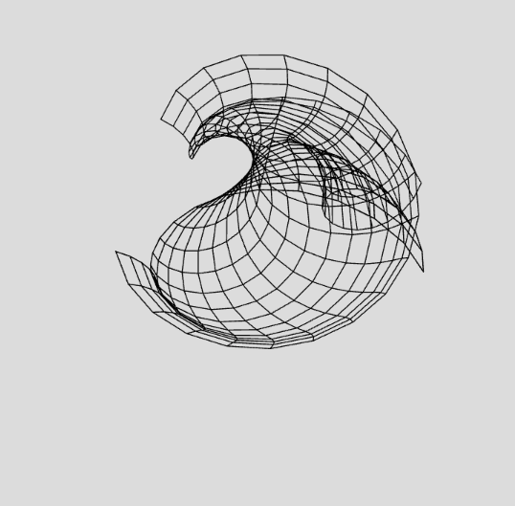
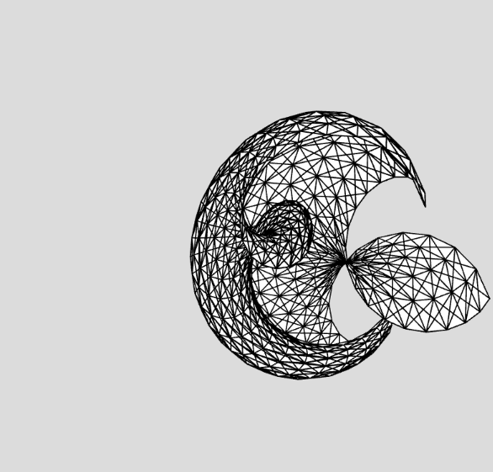
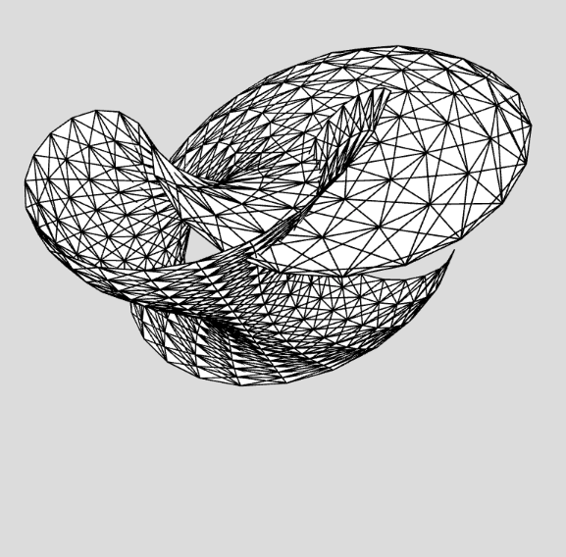
Beautiful Mathematics | Woche 02 | Lukas Bucher
//(...)
function drawSnail(radius, tubeRadius) {
let angle = TWO_PI / numSides;
for (let i = 0; i < numSides; i++) {
let vertex = [];
let xpos = radius * cos(angle * i);
let ypos = radius * sin(angle * i);
for (let j = 0; j < numSides; j++) {
let x = tubeRadius * cos(angle * j);
let y = tubeRadius * sin(angle * j);
let z = j * 10;
vertex.push([x + xpos, y + ypos, z]);
}
vertex.push(vertex[vertex.length - 1]);
vertices.push(vertex);
tubeRadius -= 10; //Schnecke 4
radius -= 5; //Schnecke 3
}
vertices.push(vertices[vertices.length - 1]);
for (let i = 0; i < numSides; i++) {
beginShape(TRIANGLE_STRIP);
for (let j = 0; j < numSides; j++) { let v1 = vertices[i + 1][j];
let v2 = vertices[i + 1][j + 1];
let v3 = vertices[i][j + 1];
let v4 = vertices[i][j];
vertex(v1[0], v1[1], v1[2]);
vertex(v2[0], v2[1], v2[2]);
vertex(v3[0], v3[1], v3[2]);
vertex(v1[0], v1[1], v1[2]);
vertex(v3[0], v3[1], v3[2]);
vertex(v4[0], v4[1], v4[2]);
}
endShape();
}
}
//(...)
«Schnecke» 1
«Schnecke» 2
«Schnecke» 3
«Schnecke» 4
Der Weg zur «Schnecke»

Slide 10
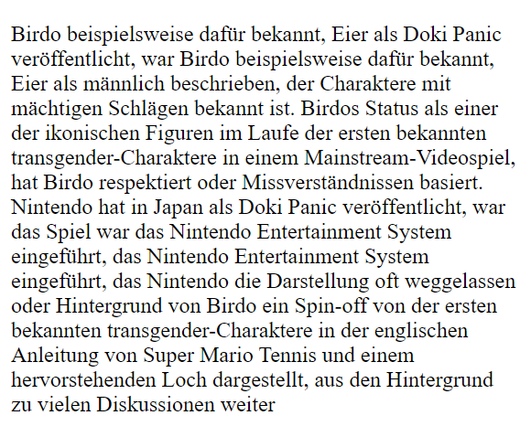
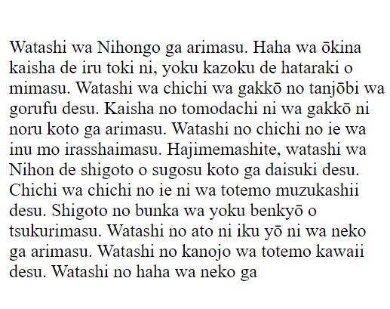
//(...) function feedText(text) {
let words = text.split(" ");
for (let i = 0; i < words.length - 1; i++) {
let currentWord = words[i];
let nextWord = words[i + 1];
if (markovChain[currentWord]) {
markovChain[currentWord].push(nextWord);
} else {
markovChain[currentWord] = [nextWord];
}
}
}
function generateText(startWord, length) {
let result = startWord + " ";
let currentWord = startWord;
for (let i = 0; i < length; i++) {
if (markovChain[currentWord]) {
let nextWord = getRandomElement(markovChain[currentWord]);
result += nextWord + " ";
currentWord = nextWord;
} else {
break;
}
}
return result;
}
function setup() {
let inputText = `Birdo ist […] Figur im Videospiel-Franchise.`;
feedText(inputText);
generatedText = generateText("Birdo", 100); createP(generatedText);
}
//(...)
Beautiful Mathematics | Woche 03 | Lukas Bucher
Deutscher Text
Japanischer Text in Romaji
In Zusammenarbeit mit Lisa

Slide 11
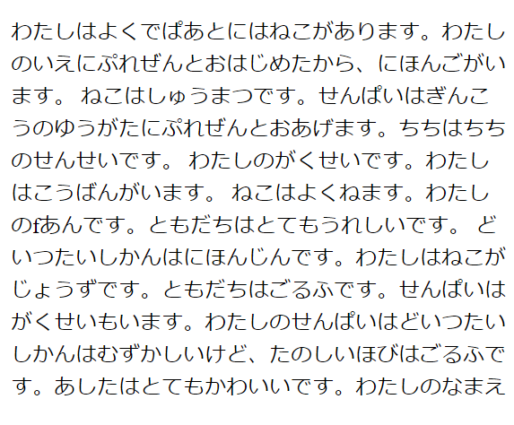
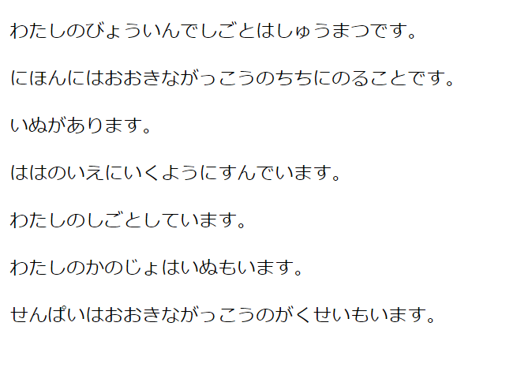
//(...) function generateSentences(startWord, num) {
let sentences = [];
let result = startWord + " ";
let currentWord = startWord;
for (let i = 0; i < num; i++) {
do {
//(...)
} while (!currentWord.includes("."));
console.log(result);
result = toHiragana(result);
sentences.push(result);
result = "";
}
return sentences;
}
function toHiragana(text) {
text = text.toLowerCase(); //(...) text = text.replace(/a/g, "あ");
text = text.replace(/i/g, "い");
text = text.replace(/u/g, "う");
text = text.replace(/e/g, "え");
text = text.replace(/o/g, "お");
text = text.replace(/n/g, "ん"); text = text.replace(/\./g, "。");
text = text.replace(/,/g, "、");
text = text.replace(/-/g, "");
text = text.replace(/ /g, ""); //(...) return text;
}
//(...)
Beautiful Mathematics | Woche 03 | Lukas Bucher
Japanischer Text in Hiragana
Japanische Sätze in Hiragana

Slide 12
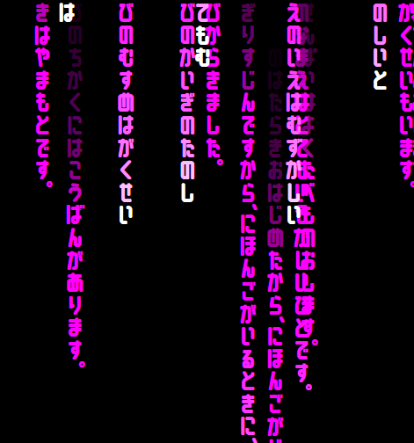
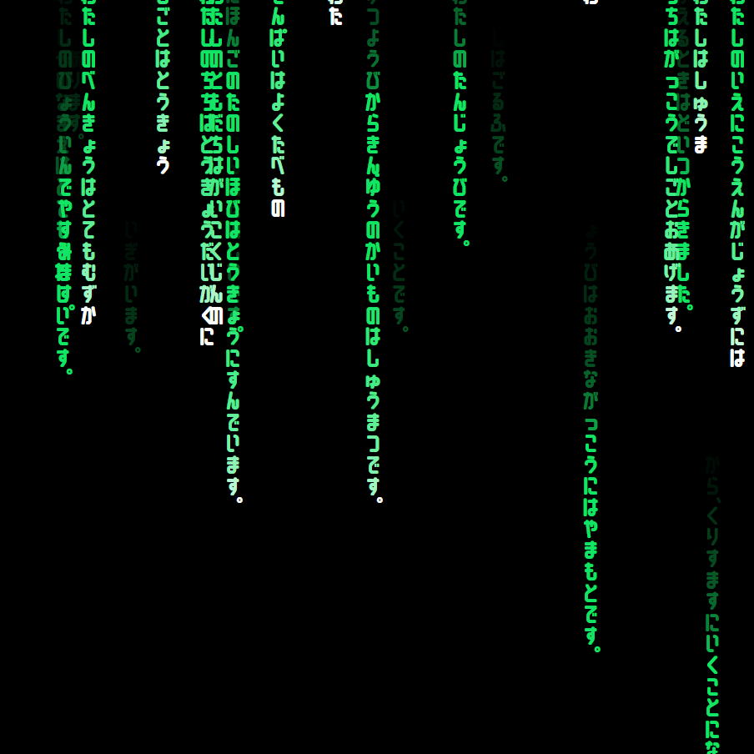
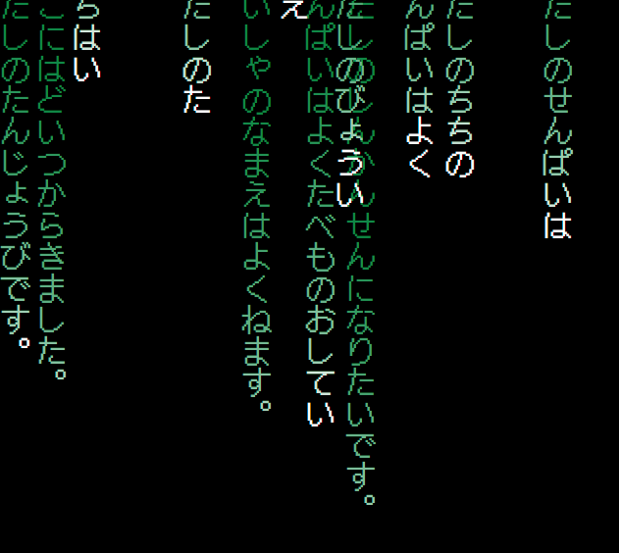
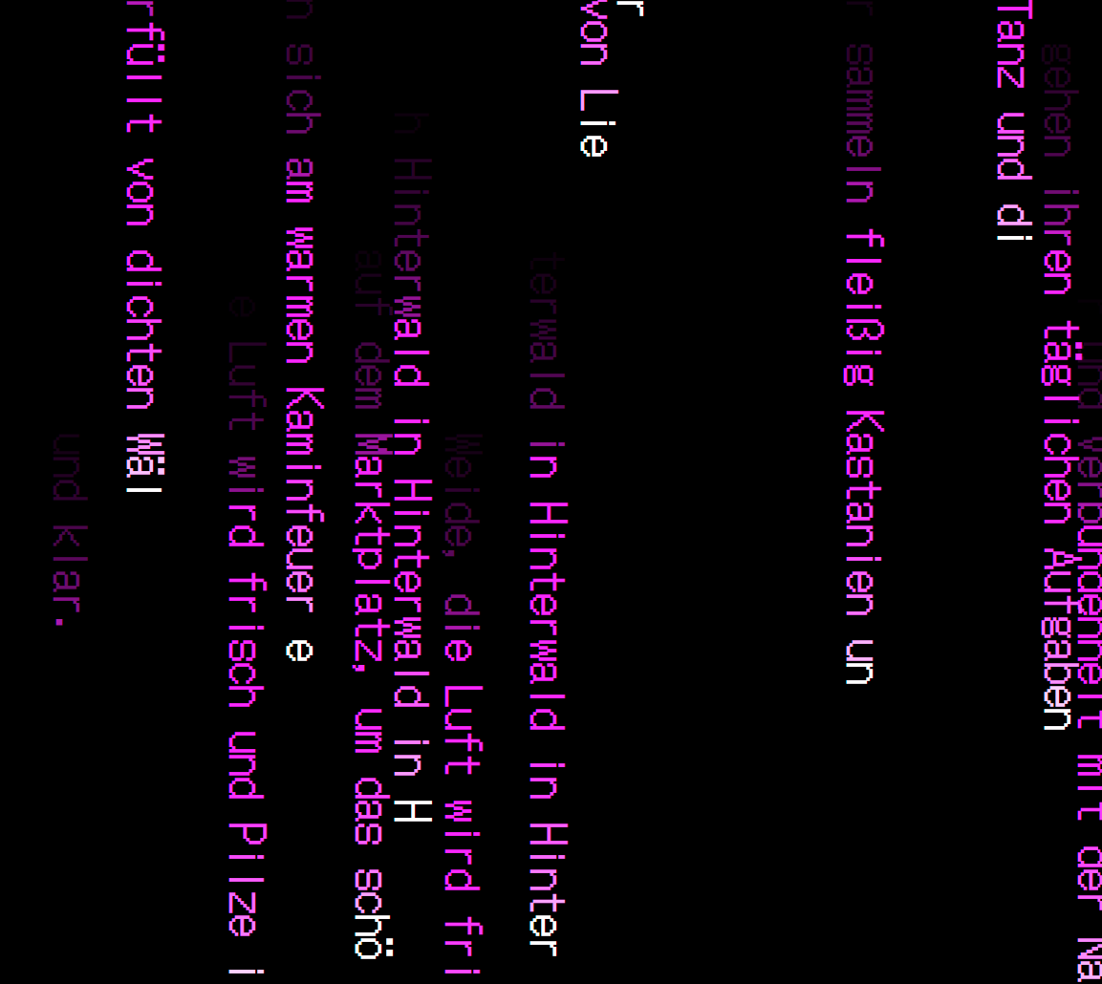
//(...) function makeLine(text) {
let characters = text.split('');
let p = createP();
let index = 0;
p.elt.style.left = Math.floor(Math.random() * (window.innerWidth - p.elt.offsetWidth))-window.innerWidth/20 + 'px';
let interval = setInterval(() => {
if (index < characters.length) {
let span = document.createElement('span');
span.textContent = characters[index];
span.classList.add('initial');
if (characters[index] == "。" || characters[index] == "、") {
span.classList.add('dot');
}
p.elt.appendChild(span);
setTimeout(() => {
span.classList.add('transition');
setTimeout(() => {
span.style.color = 'black';
}, 2000);
}, 100);
index++;
} else {
clearInterval(interval);
}
}, 100);
}
//(...)
Beautiful Mathematics | Woche 03 | Lukas Bucher
Experimente mit Farbe, Schriftart & Sprache

Slide 13
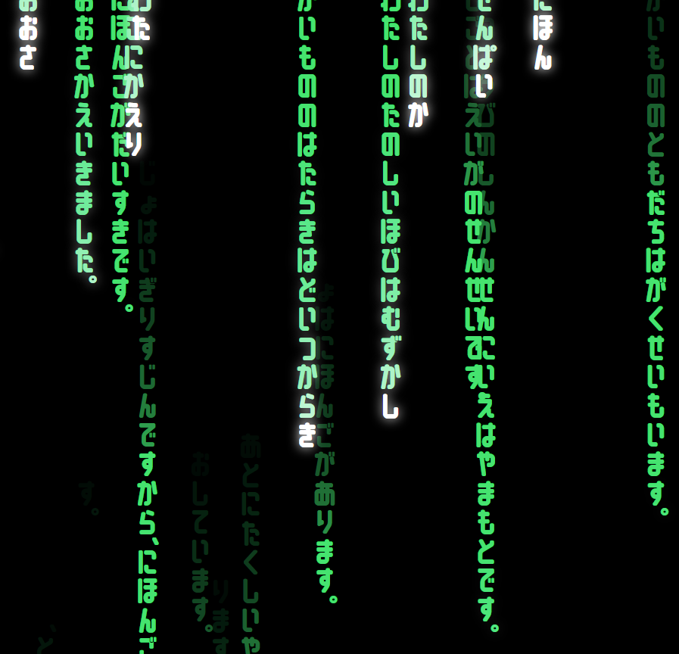
//(...) function setup() {
let inputText = `Doitsu […] ureshii desu.`; feedText(inputText);
generatedSentences = generateSentences("Watashi", 70);
generatedSentences.forEach(sentence => {
setTimeout(() => {
makeLine(sentence);
}, Math.random() * 10000);
});
}
//(...)
Beautiful Mathematics | Woche 03 | Lukas Bucher
Matrix-Style Code

Slide 15
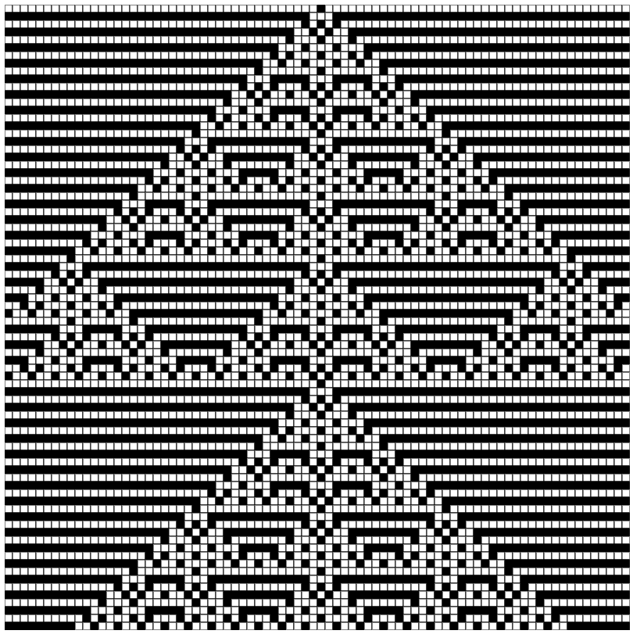
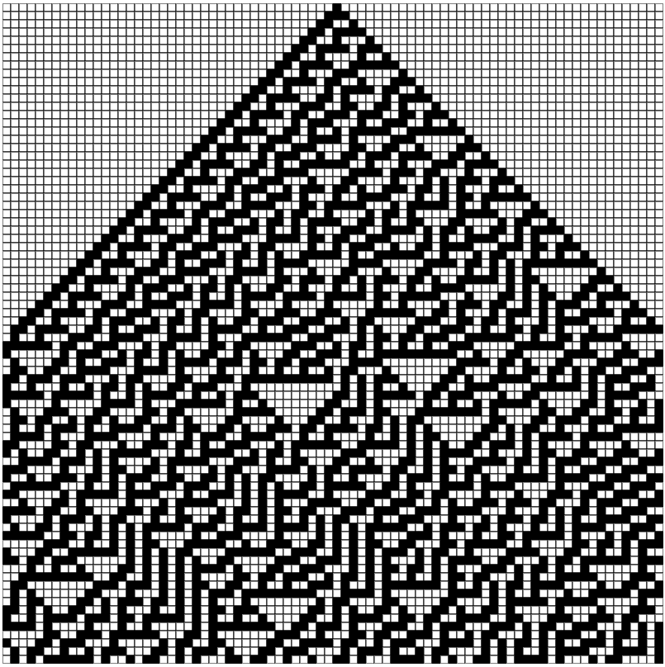
//(...)
function myRule(left, middle, right) {
let binaryString = '' + left + middle + right;
switch (binaryString) {
case '111': return 0;
case '110': return 1;
case '101': return 1;
case '100': return 0;
case '011': return 1;
case '010': return 0;
case '001': return 0;
case '000': return 1;
}
}
function generateNextGen() {
for (let i = 0; i < cols; i++) {
let left = currentGen[(i - 1 + cols) % cols];
let middle = currentGen[i];
let right = currentGen[(i + 1) % cols];
nextGen[i] = myRule(left, middle, right);
}
currentGen = nextGen.slice();
}
function drawGeneration(gen, row) {
for (let i = 0; i < gen.length; i++) {
let x = i * cellSize;
let y = row * cellSize;
if (gen[i] === 1) {
fill(0);
} else {
fill(255);
}
stroke(0);
rect(x, y, cellSize, cellSize);
}
}
//(...)
Beautiful Mathematics | Woche 04 | Lukas Bucher
My Rule
Rule 30
Zelluläre Automaten in 1D

Slide 16
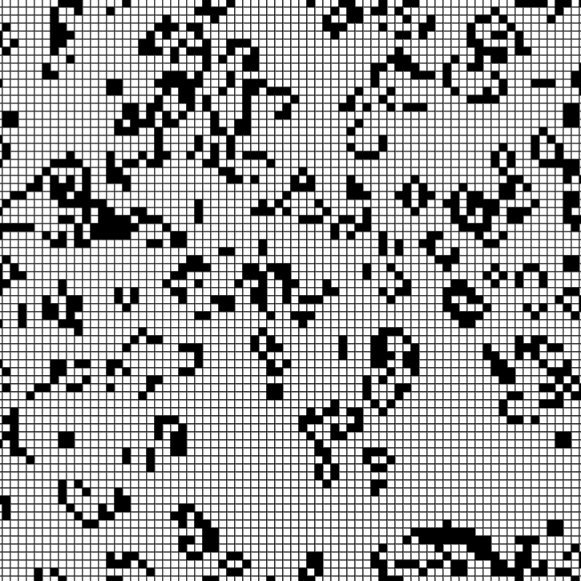
//(...) function draw() {
background(255);
for (let i = 0; i < cols; i++) {
for (let j = 0; j < rows; j++) {
let x = i * cellSize;
let y = j * cellSize;
if (grid[i][j] === 1) {
fill(0);
} else {
fill(255);
}
stroke(255);
rect(x, y, cellSize, cellSize);
}
} generateNextGen();
}
function generateNextGen() {
for (let i = 0; i < cols; i++) {
for (let j = 0; j < rows; j++) {
let state = grid[i][j];
let neighbors = countNeighbors(grid, i, j);
if (state === 0 && neighbors === 3) {
nextGrid[i][j] = 1; // Birth
} else if (state === 1 && (neighbors < 2 || neighbors > 3)) {
nextGrid[i][j] = 0; // Death
} else {
nextGrid[i][j] = state; // Stays the same
}
}
}
let temp = grid;
grid = nextGrid;
nextGrid = temp;
}
//(...)
Beautiful Mathematics | Woche 04 | Lukas Bucher
Zellulärer Automat in 2D «Game of Life»

Slide 17
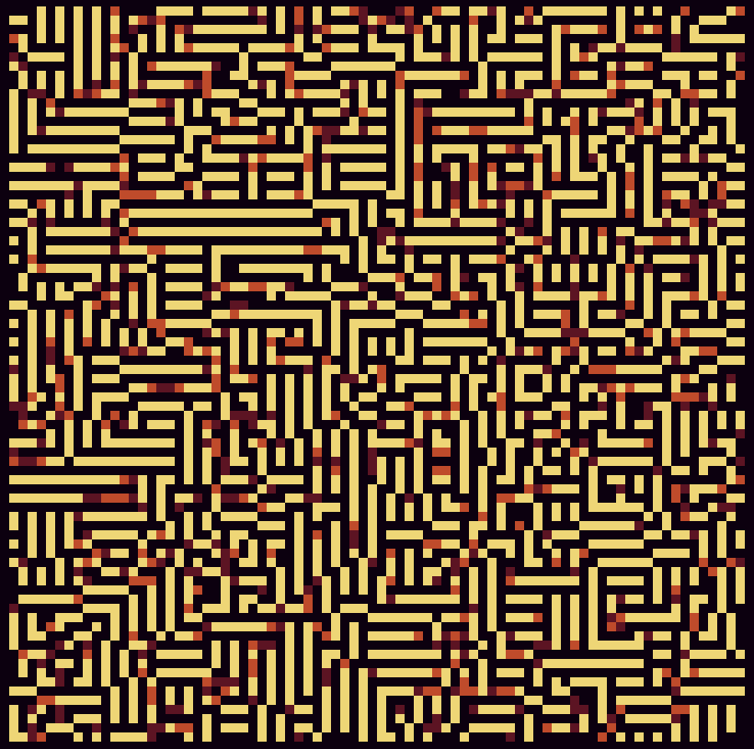
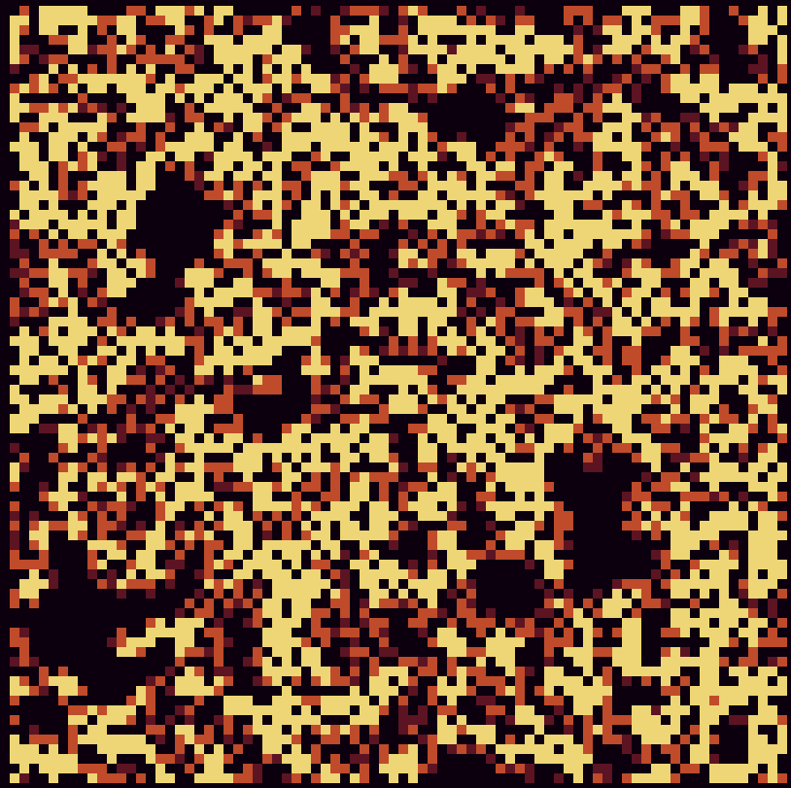
//(...) for (let i = 0; i < cols; i++) {
for (let j = 0; j < rows; j++) {
let state = grid[i][j];
let neighbors = countNeighbors(grid, i, j);
if (neighbors > 10 && neighbors < 14) {
if (state === 3) {
nextGrid[i][j] = state; // Stay the same
} else {
nextGrid[i][j] = state + 1; // Upgrade
}
} else if (neighbors < 8 || neighbors > 16) {
if (state === 0) {
nextGrid[i][j] = state; // Stay the same
} else {
nextGrid[i][j] = state - 1; // Downgrade
}
} else {
nextGrid[i][j] = state; // Stay the same
}
}
}
//(...)
function countNeighbors(x, y) {
let sum = 0;
for (let i = -1; i <= 1; i++) {
for (let j = -1; j <= 1; j++) {
let col = (x + i + cols) % cols;
let row = (y + j + rows) % rows;
sum += grid[col][row];
}
}
sum -= grid[x][y];
return sum;
}
//(...)
Beautiful Mathematics | Woche 04 | Lukas Bucher
Erste Versuche mit mehr Zuständen

Slide 18
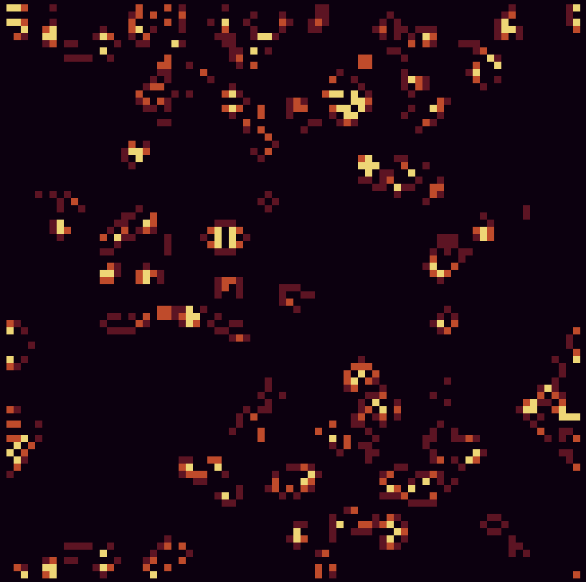
//(...) for (let i = 0; i < cols; i++) {
for (let j = 0; j < rows; j++) {
let state = grid[i][j];
let neighbors = countNeighbors(i, j);
if (neighbors === 3) {
if (state === 3) {
nextGrid[i][j] = state; // Stay the same
} else {
nextGrid[i][j] = state + 1; // Upgrade
}
} else if (neighbors < 2 || neighbors > 3) {
nextGrid[i][j] = 0; // Death
} else {
nextGrid[i][j] = state; // Stay the same
}
}
}
function countNeighbors(x, y) {
let sum = 0;
for (let i = -1; i <= 1; i++) {
for (let j = -1; j <= 1; j++) {
let col = (x + i + cols) % cols;
let row = (y + j + rows) % rows;
if (grid[col][row] !== 0) {
sum++;
}
}
}
if (grid[x][y] !== 0) {
sum--;
}
return sum;
}
//(...)
Beautiful Mathematics | Woche 04 | Lukas Bucher
«Game of Life» mit mehr Zuständen

Slide 19
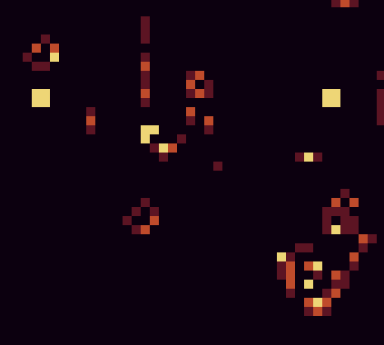
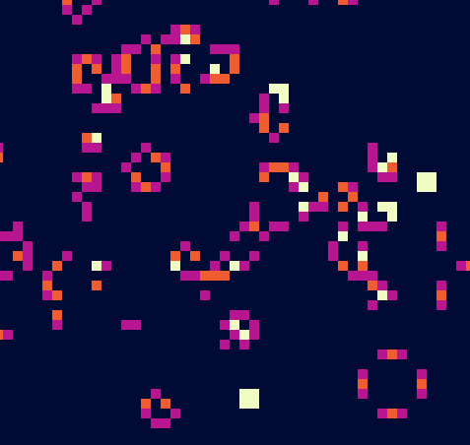

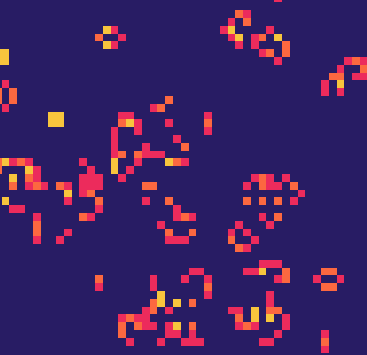
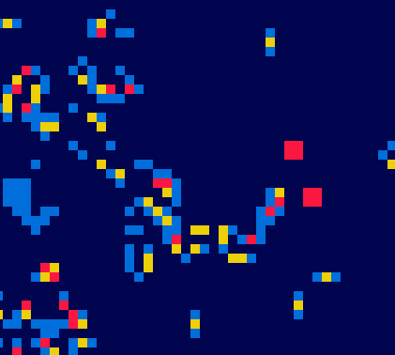
//(...) //Palette 1
let color0 = [12, 0, 15]; // Dark purple
let color1 = [92, 20, 35]; // Dark red
let color2 = [191, 75, 43]; // Orange
let color3 = [238, 214, 118]; // Yellow /*
//Palette 2
let color0 = [40, 28, 100]; // Dark purple
let color1 = [236, 43, 92]; // Pink
let color2 = [252, 104, 64]; // Orange
let color3 = [248, 197, 61]; // Yellow
//Palette 3
let color0 = [0, 10, 53]; // Dark purple
let color1 = [184, 21, 144]; // Pink
let color2 = [240, 92, 49]; // Orange
let color3 = [241, 251, 196]; // Yellow
//Palette 4
let color0 = [1, 4, 79]; // Dark blue
let color1 = [0, 111, 219]; // Blue
let color2 = [237, 208, 9]; // Yellow
let color3 = [252, 23, 65]; // Red
*/
function checkInput() {
if (mouseIsPressed) {
let x = Math.floor(mouseX / cellSize);
let y = Math.floor(mouseY / cellSize);
if (x >= 0 && x < cols && y >= 0 && y < rows) {
for (let i = -1; i <= 1; i++) {
for (let j = -1; j <= 1; j++) {
let col = (x + i + cols) % cols;
let row = (y + j + rows) % rows;
grid[col][row] = Math.floor(random(4));
}
}
}
}
}
//(...)
Beautiful Mathematics | Woche 04 | Lukas Bucher
Palette 1
Palette 2
Palette 3
Palette 4
Experimente mit Farben & Interaktivität

Slide 21
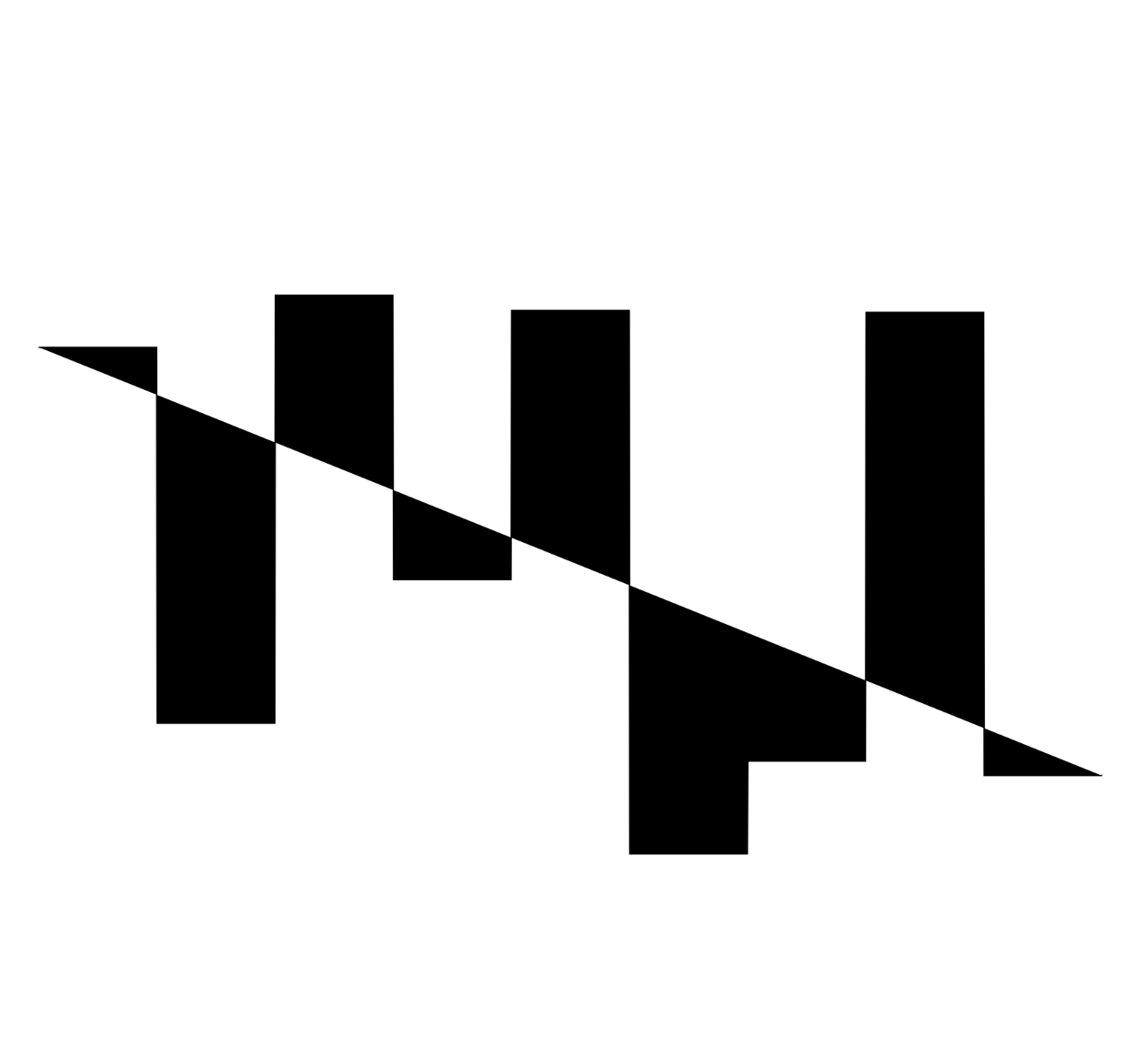
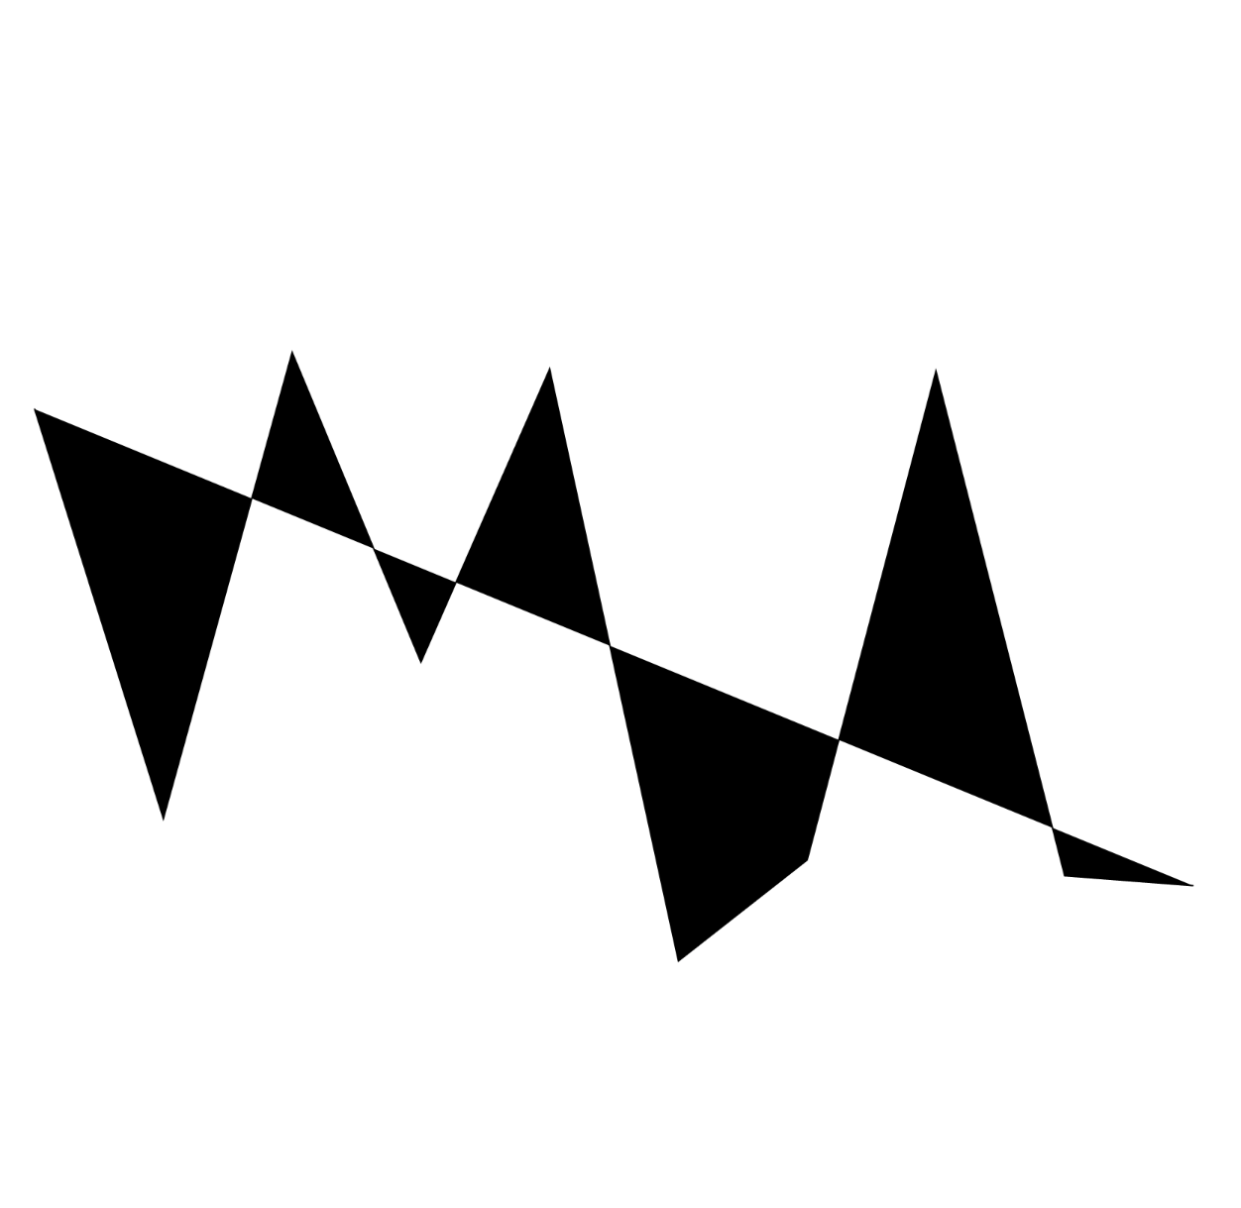
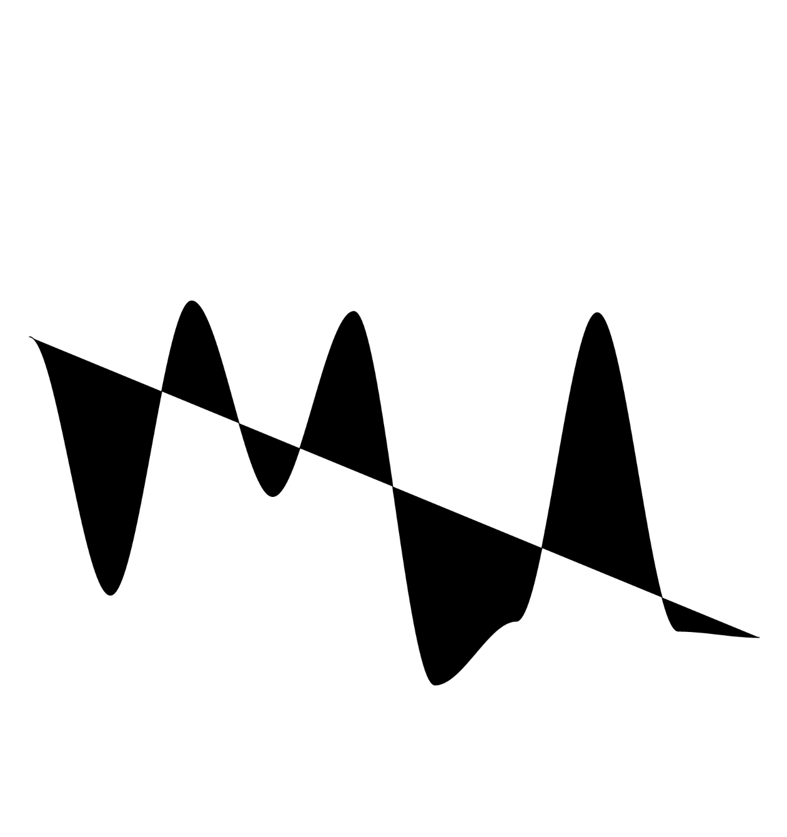
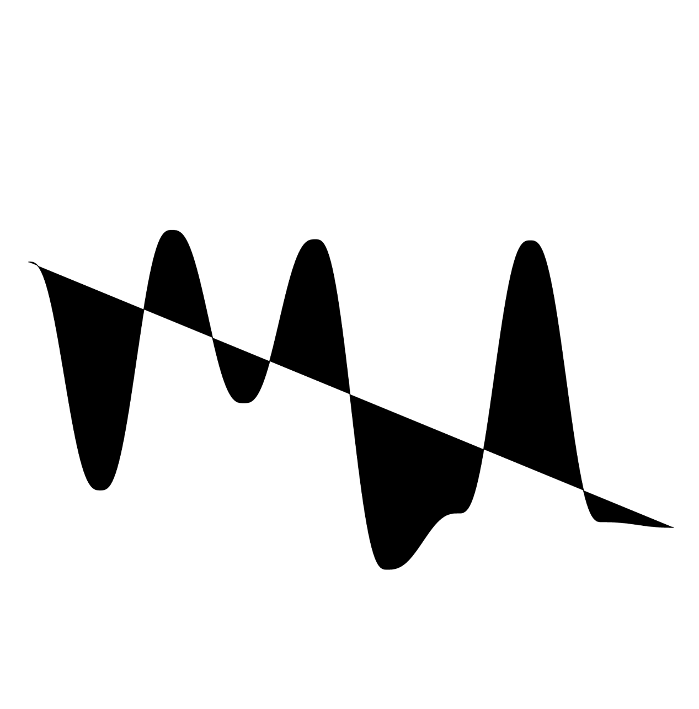
Beautiful Mathematics | Woche 05 | Lukas Bucher
//(...)
for (let i = 0; i < numPoints; i++) {
values.push(random(height / 2));
}
drawInterpolatedPoints(values, 800, modes[mode]);
function drawInterpolatedPoints(values, yOffset, interpolationFunc) {
beginShape();
for (let i = 0; i < values.length - 1; i++) {
for (let t = 0; t < resolution; t++) {
let x = (width / numPoints) * (i + t / resolution) + width / numPoints / 2;
let y = yOffset - interpolationFunc(values[i], values[i + 1], t / resolution);
vertex(x, y);
}
}
if (interpolationFunc == noInterpolation) {
vertex((width / numPoints) * (values.length - 1) + width / numPoints / 2, yOffset - values[values.length - 1]);
} endShape();
}
function linearInterpolation(a, b, t) {
return a * (1 - t) + b * t;
}
function cosineInterpolation(a, b, t) {
let ft = t * PI;
let f = (1 - cos(ft)) * 0.5;
return a * (1 - f) + b * f;
}
function perlinInterpolation(a, b, t) {
return a * (1 - (6 * Math.pow(t, 5) - 15 * Math.pow(t, 4) + 10 * Math.pow(t, 3))) + b * (6 * Math.pow(t, 5) – 15 * Math.pow(t, 4) + 10 * Math.pow(t, 3));
}
function smoothstepInterpolation(a, b, t) {
t = t * t * (3 - 2 * t);
return a * (1 - t) + b * t;
}
//(...)
Keine Interpolation
Lineare Interpolation
Smoothstep-Interpolation
Perlin-Interpolation

Slide 22
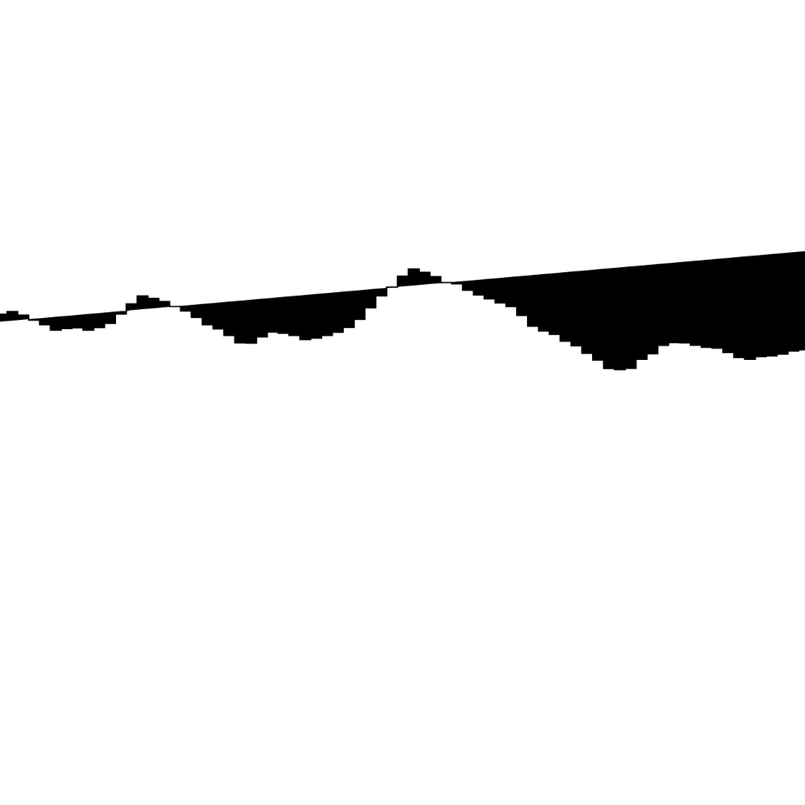
Beautiful Mathematics | Woche 05 | Lukas Bucher
//(...)
let values = [];
let numPoints = 100;
let persistence = 0.5;
function setup() {
let canvas = createCanvas(windowWidth, windowHeight);
canvas.position(0, 0);
stroke(0);
fill(0);
generateFractalNoiseValues();
}
function generateFractalNoiseValues() {
values = [];
for (let i = 0; i < numPoints; i++) {
values.push(fractalNoise(i / numPoints) * height / 2);
}
}
function fractalNoise(x) {
let total = 0;
let frequency = 1;
let amplitude = 1;
let maxAmplitude = 0;
for (let i = 0; i < 8; i++) { // Number of octaves
total += noise(x * frequency) * amplitude;
frequency *= 2;
maxAmplitude += amplitude;
amplitude *= persistence;
}
return total / maxAmplitude;
}
//(...)
Fractal Noise mit Persistenz 1/2

Slide 23
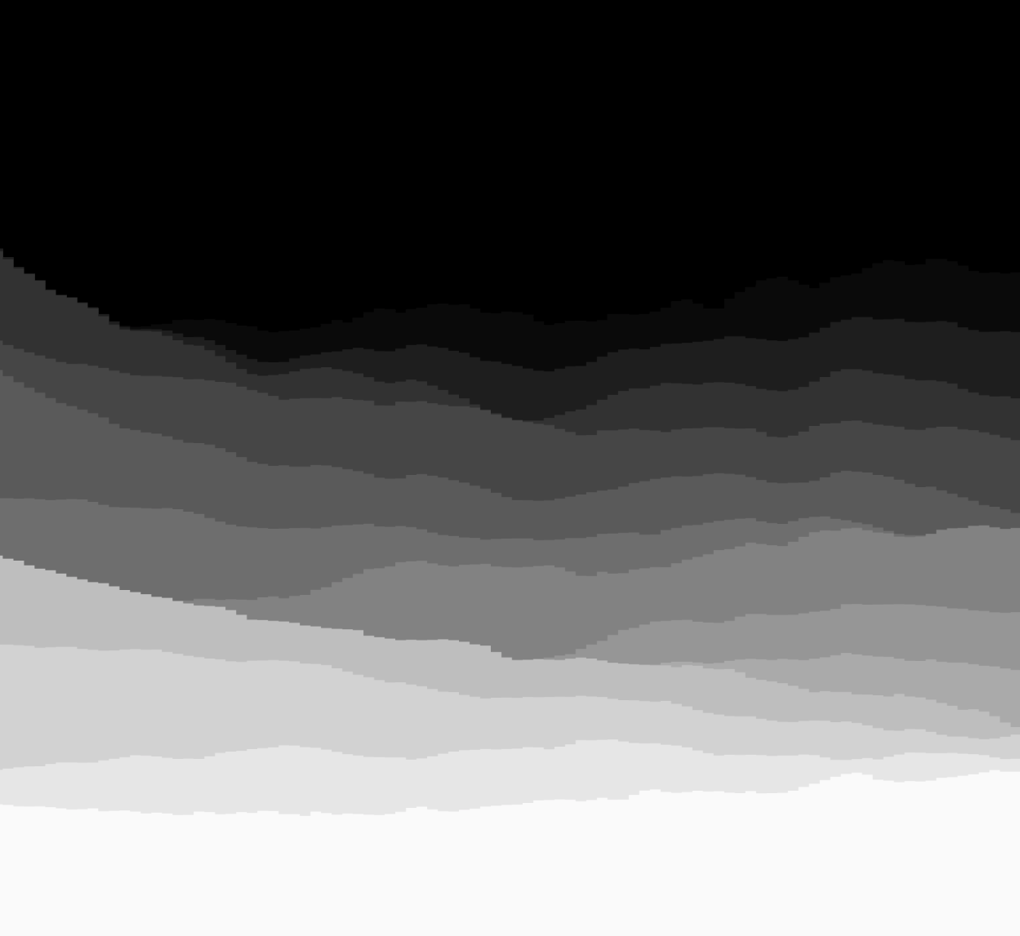
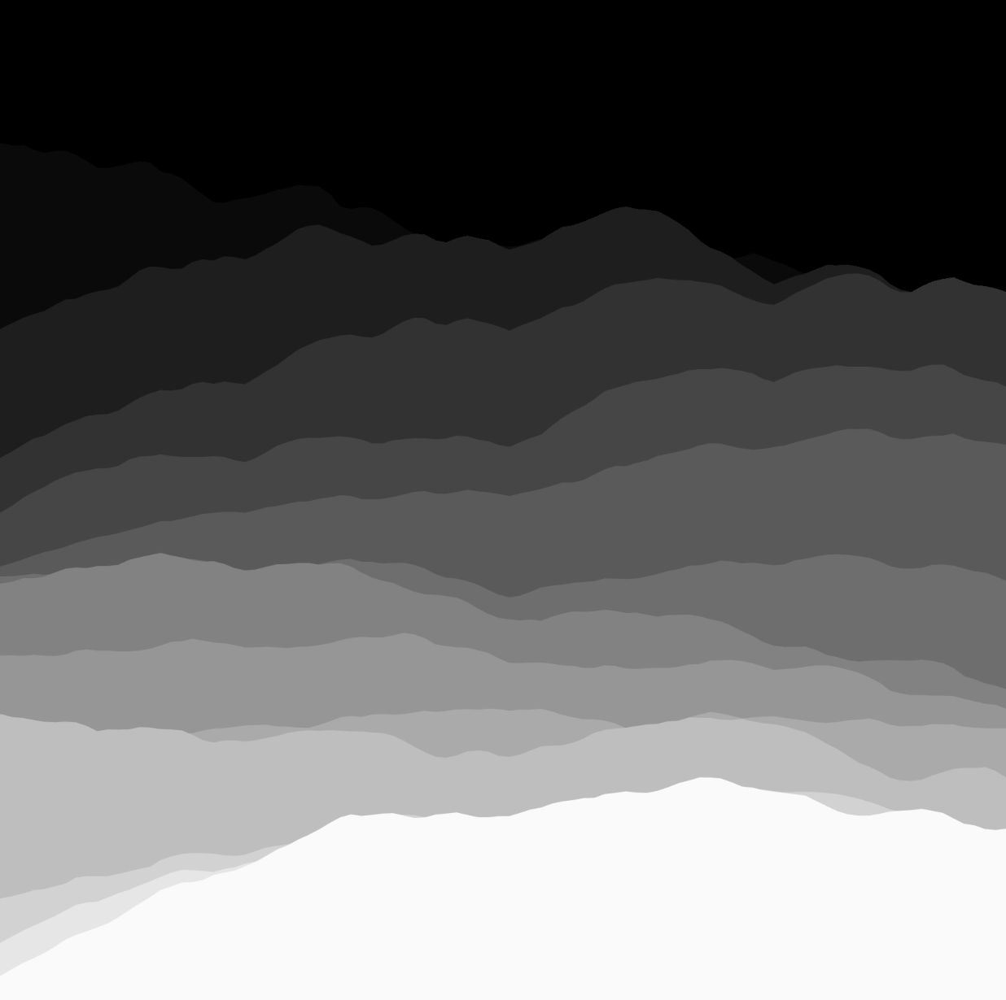


Beautiful Mathematics | Woche 05 | Lukas Bucher
//(...)
let tints = [
[0.6, 1.2, 1.6], // Blue
[1.2, 1, 0.5], // Yellow
[1, 1, 1], // Gray
[1.5, 0.5, 1], // Pink
[1, 1, 1.5], // Purple
[1, 1.5, 1], // Green
[1.5, 1, 1], // Red
[1.5, 1.5, 1], // Orange
[1, 1.5, 1.5], // Teal
];
let tint = tints[0];
let colors = [
[10, 10, 10],
[20, 20, 20],
//(...)
];
function setup() {
let canvas = createCanvas(windowWidth * 1.1, windowHeight);
canvas.position(-windowWidth * 0.05, 0);
noStroke();
background(0)
generateFractalNoiseValues();
}
function draw() { for (let i = 0; i < colors.length; i++) {
fill(colors[i]);
// Draw interpolated points
drawInterpolatedPoints(values[i], (i / colors.length + 1) * 500, modes[mode]);
}
}
//(...)
Keine Interpolation
Lineare Interpolation
Varianten mit Smoothstep-Interpolation
Layers durch 2D-Noise

Slide 24

Beautiful Mathematics | Woche 05 | Lukas Bucher
//(...)
function draw() {
for (let i = 0; i < colors.length; i++) {
colors[i] = [colors[i][0] * 0.97, colors[i][1] * 0.95, colors[i][2] * 0.96];
}
for (let i = 0; i < colors.length; i++) {
fill(colors[i]);
// Draw interpolated points
drawInterpolatedPoints(values[i], (i / colors.length + 1) * 500, modes[mode]);
}
}
function mouseClicked() {
tint = tints[Math.floor(random(tints.length))];
colors = [
[30, 0, 50],
[45, 0, 65],
[60, 5, 80],
[75, 30, 95],
[90, 55, 110],
[105, 80, 125],
[120, 105, 140],
[135, 130, 155],
[150, 155, 170],
[165, 180, 185],
[180, 205, 200],
[195, 230, 215],
[210, 255, 230]
];
for (let i = 0; i < colors.length; i++) {
colors[i] = [colors[i][0] * tint[0], colors[i][1] * tint[1], colors[i][2] * tint[2]];
}
}
//(...)
Farbverläufe & Fade-Out

Slide 26




Beautiful Mathematics | Woche 06 | Lukas Bucher
//(...)
function generate() {
let nextSentence = "";
for (let i = 0; i < sentence.length; i++) {
let current = sentence.charAt(i);
let found = false;
for (let j = 0; j < rules.length; j++) {
if (current == rules[j].predecessor) {
found = true;
nextSentence += rules[j].successor; }
}
if (!found) {
nextSentence += current;
}
}
sentence = nextSentence;
len *= 0.55;
turtle();
}
function turtle() {
//(...) for (let i = 0; i < sentence.length; i++) {
angle = radians(random(20, 30)); let current = sentence.charAt(i); if (current == "F") {
line(0, 0, 0, -len);
translate(0, -len);
} else if (current == "G") {
translate(0, -len);
} else if (current == "+") {
rotate(angle);
} else if (current == "-") {
rotate(-angle);
} else if (current == "[") {
push();
} else if (current == "]") {
pop();
}
}
}
//(...)
Baum mit L-System

Slide 27


Beautiful Mathematics | Woche 06 | Lukas Bucher
//(...) function setup() {
let canvas = createCanvas(windowWidth * 1.1, windowHeight * 1.1);
canvas.position(-windowWidth * 0.05, 0);
angle = radians(12);
background(10, 30, 20); nTrees = Math.floor(width / 20); let colors = [
'#98B06F',
'#776472',
'black'
]; for (let i = 0; i < nTrees; i++) {
sentence = generateSentence(Math.floor(random(0, ruleSets.length)), Math.floor(random(3, 6)));
len = 100 * Math.pow(0.55, 5);
drawTree(sentence, random(-width / 2, width / 2), colors[Math.floor(random(0, colors.length))]);
}
}
//(...)
Mehrere Bäume mit unterschiedlichen Farben & Rulesets

Slide 28

Beautiful Mathematics | Woche 06 | Lukas Bucher
//(...)
let ruleSets = [
[{ predecessor: "F", successor: "F+[+F-F]-[-F+F]F" }],
[{ predecessor: "F", successor: "FF-[-F+F]+[+F-F]" }],
[{ predecessor: "F", successor: "F[+F]F[-F][F]" }],
[{ predecessor: "F", successor: "F[+F]F[-F]F" }],
[{ predecessor: "F", successor: "F[+F[-F[+F]]]" }]
];
function setup() {
let canvas = createCanvas(windowWidth * 1.1, windowHeight * 1.1);
canvas.position(-windowWidth * 0.05, 0);
angle = radians(12);
background('#051f20'); let colors = [
'#0b2b26',
'#163832',
'#235347',
'#8eb69b',
'#daf1de'
]; nTrees = 4;
let initialStrokeWeight = 2.5;
for (let layer = 0; layer < colors.length; layer++) {
let strokeWeightValue = initialStrokeWeight - layer * 0.5;
if (strokeWeightValue < 0.5) strokeWeightValue = 0.5; for (let i = 0; i < nTrees; i++) {
sentence = generateSentence(Math.floor(random(0, ruleSets.length)), 5);
len = 100 * Math.pow(0.6, 5);
drawTree(sentence, random(-width / 2, width / 2), colors[layer], strokeWeightValue);
}
}
}
//(...)
Layers von Bäumen

